Slide 1


Real Waste Classification CNN for Sustainable Waste Management
by Dadi kumar naidu

Slide 2
Problem Statement
The problem is the growing environmental impact of waste, especially in urban environments.
There's a need for innovative solutions to monitor, optimize, and manage waste effectively.

Slide 3
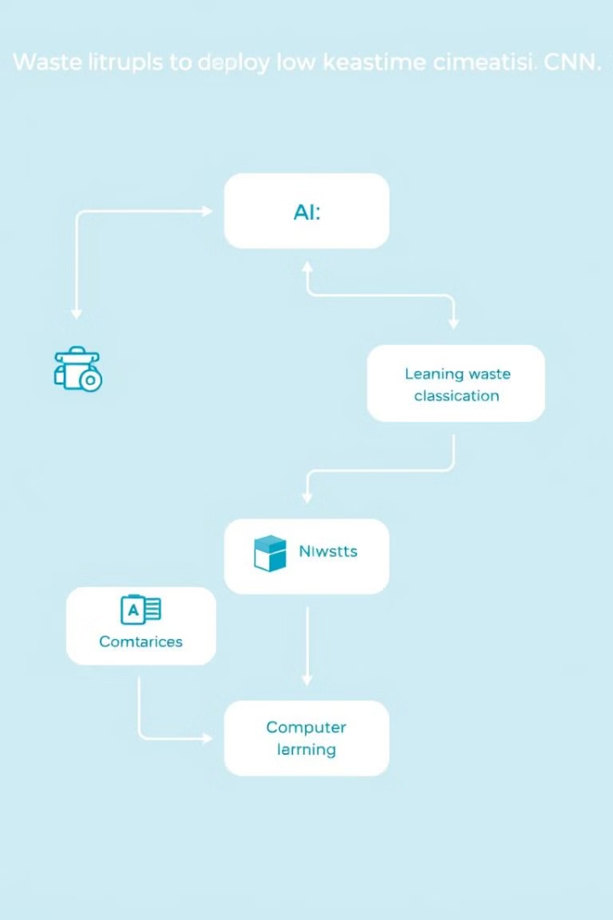
Technologies Used
1
Machine Learning & Deep Learning
2
Computer Vision

Slide 4
TensorFlow & Keras for CNN Model Building and Training
TensorFlow is an open-source library used for building and training deep learning models.
Keras is a high-level API that simplifies the process of building and training neural networks on top of TensorFlow.

Slide 5
InceptionV3 Pre-Trained Model for Image Classification
InceptionV3 is a pre-trained model that has been trained on a large dataset of images.
This pre-trained model can be used as a starting point for our waste classification task.

Slide 6
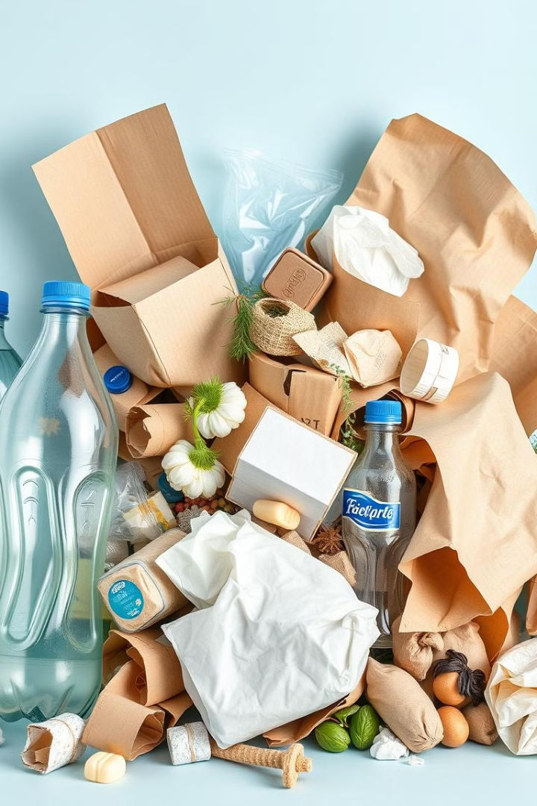
Computer Vision Techniques for Waste Recognition
Image processing techniques are used to extract features from waste images.
These features are then used to train a CNN model to recognize different types of waste.

Slide 7
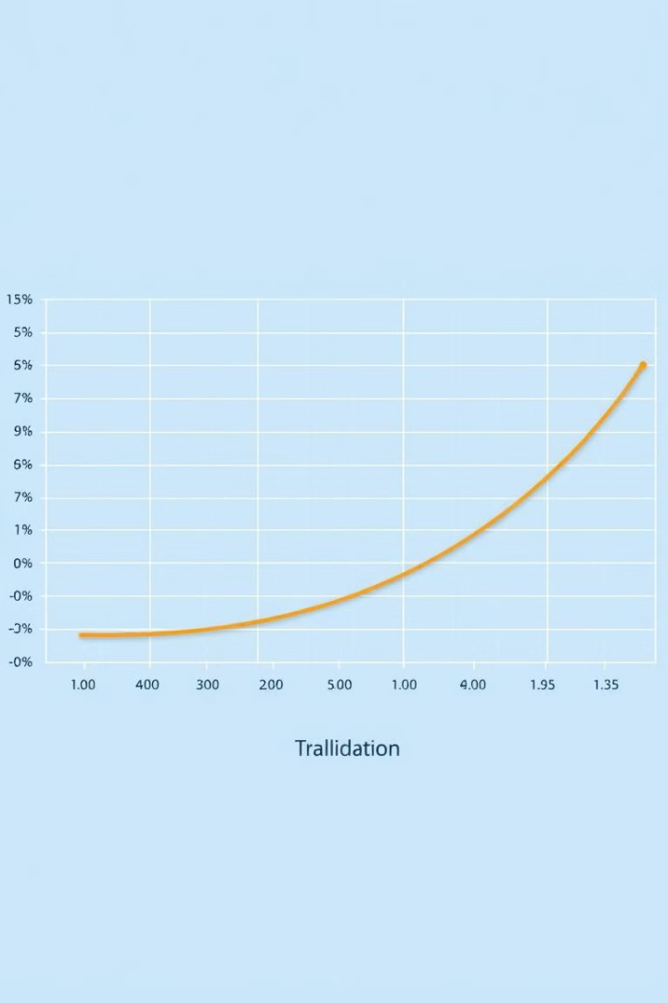
Model Training and Validation Processes
Training the CNN model involves feeding it with labeled waste images.
The model learns to classify waste based on the provided labels.
Validation data is used to evaluate the model's performance on unseen images.

Slide 8




Deployment and Real-World Applications
The trained CNN model can be deployed on smart devices like cameras.
It can be used to automatically classify waste in real-time.
This can contribute to more efficient waste management and recycling processes.

